Slide 1
COVID-19 Vaccination
Data Analysis
Edara Sai Srija: ID-1275300
Isabella Soldati Mol: ID- 1272045
Mehreet Singh Bajaj: ID- 1274698
Mohammed Safwan Aslam Kazi: ID- 1270795

Slide 2
Introduction
Problem Statement:
Data Analysis of enormous data for COVID Vaccination.
Implementation:
Implementation of many data visualization techniques.
Derivatives:
What vaccination schemes are used in various countries
Total number of vaccinations and percent of vaccinations
Daily vaccinations and daily vaccinations per million
Total people vaccinated and percent of people vaccinated

Slide 3
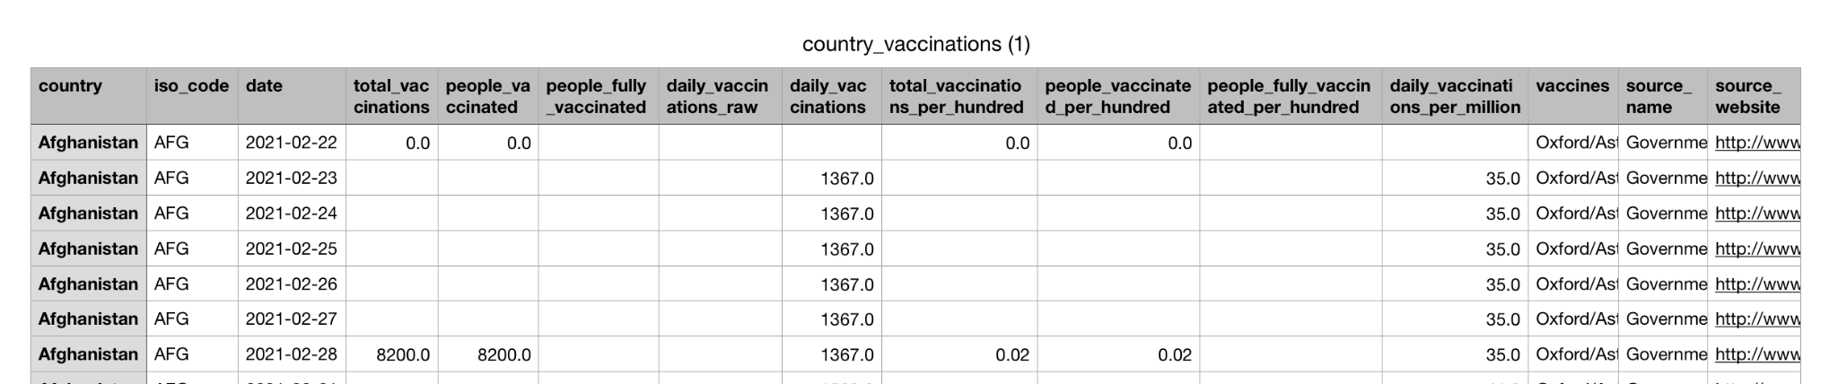
Data Description
“COVID World Vaccination Progress”
Source: https://www.kaggle.com/gpreda/covid-world-vaccination-progress
10199 rows and 15 columns
Sample:

Slide 4
Data Attributes
Country: country for which the vaccination information is provided;
Country ISO Code: unique code for the country;
Date: date for the data entry;
Total number of vaccinations: this is the absolute number of total immunizations in the country;
Total number of people vaccinated: number of people vaccinated (not necessarily fully vaccinated depending on immunization scheme)
Total number of people fully vaccinated: number of people that received the entire set of immunization according to the immunization scheme (typically 1 or 2 doses)
Daily vaccinations (raw): the number of vaccination for that date/country;
Daily vaccinations: the number of vaccination for that date/country;
Total vaccinations per hundred: ratio (in percent) between vaccination number and total population up to the date in the country;
Total number of people vaccinated per hundred: ratio (in percent) between population immunized and total population up to the date in the country;
Total number of people fully vaccinated per hundred: ratio (in percent) between population fully immunized and total population up to the date in the country;
Number of vaccinations per day: number of daily vaccination for that day and country;
Daily vaccinations per million: ratio (in ppm) between vaccination number and total population for the current date in the country;
Vaccines used in the country: vaccine provider used in the country
Source name: source of the information (national authority, international organization, local organization etc.);
Source website: website of the source of information;

Slide 5

Operation Environment
Python libraries used:
Pandas
Numpy
Matplotlib
Seaborn
Plotly

Slide 6
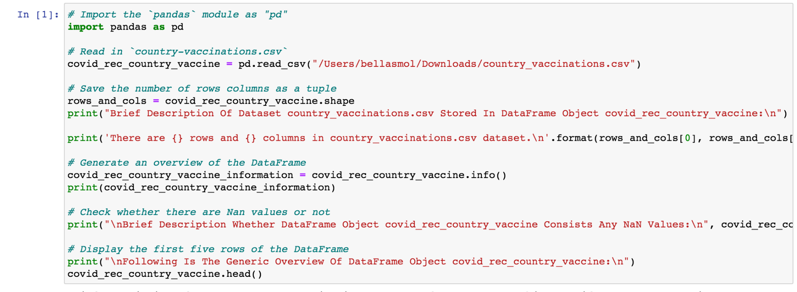
Approach
Read data as a .csv file using Pandas library

Slide 7
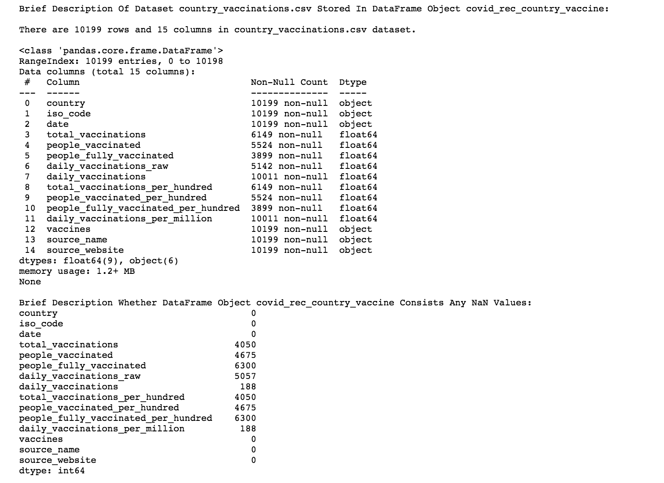

Slide 8
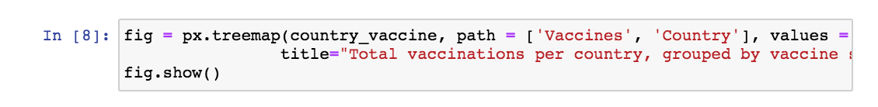
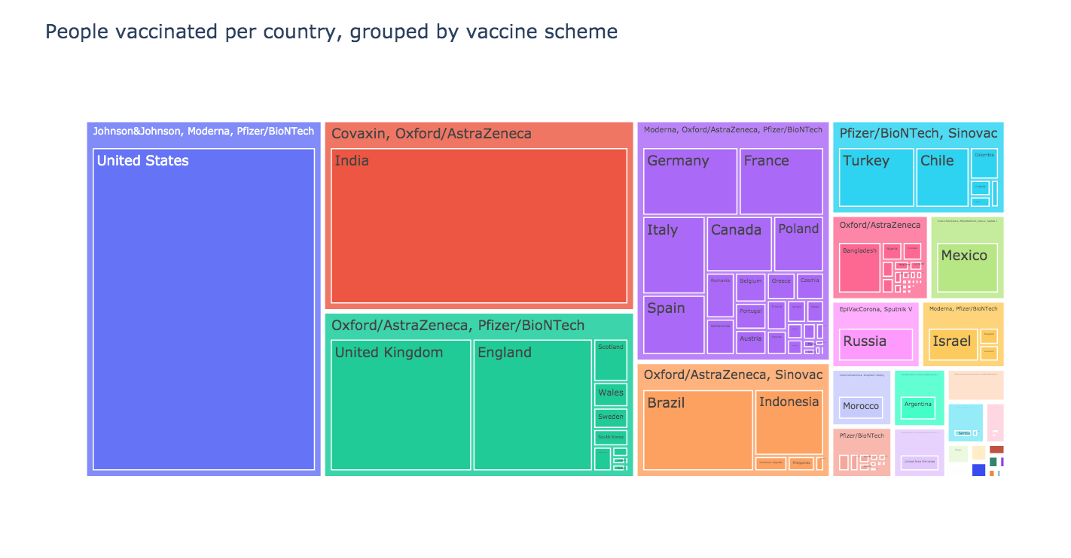
Experiments
& Results
Tree Maps
Although the USA is the country that has more people vaccinated, China is the country with more daily vaccination followed by India.

Slide 9
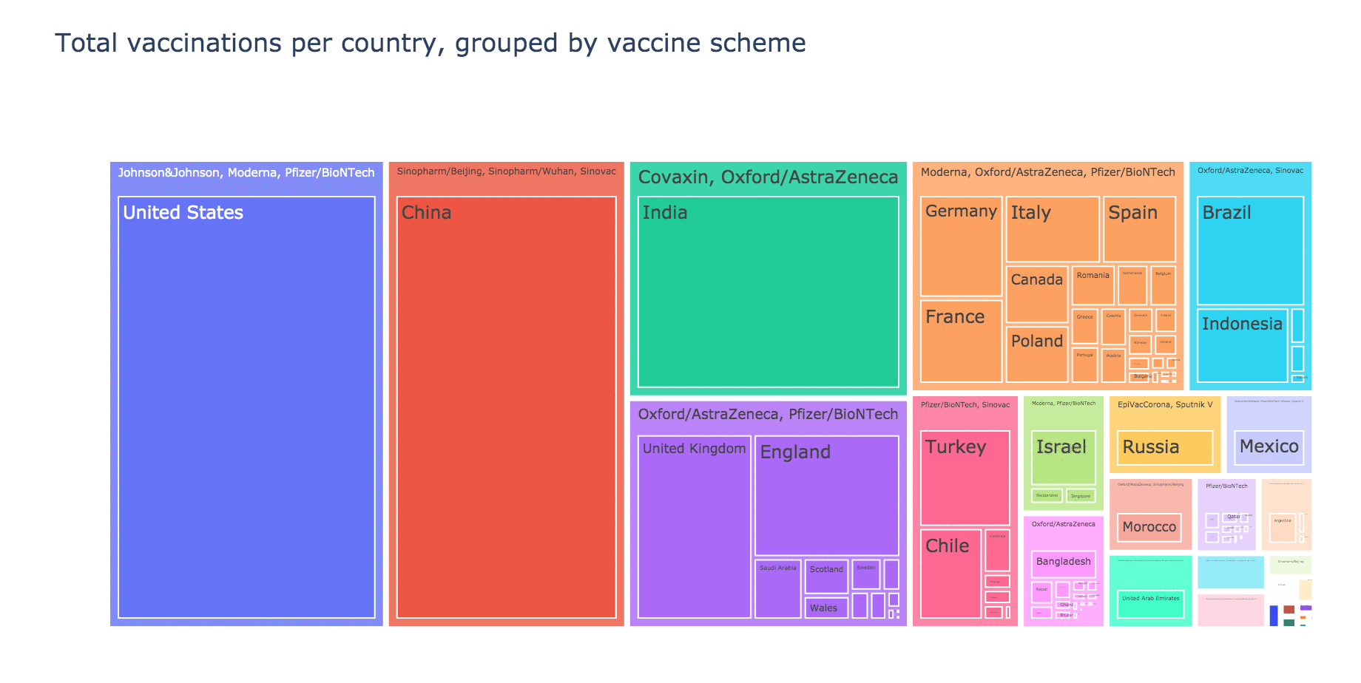
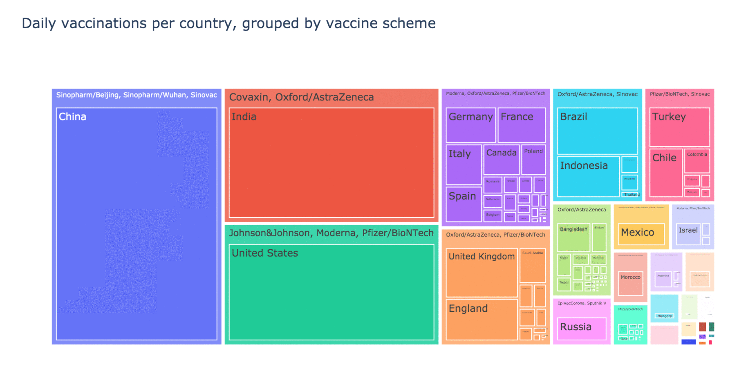

Slide 10
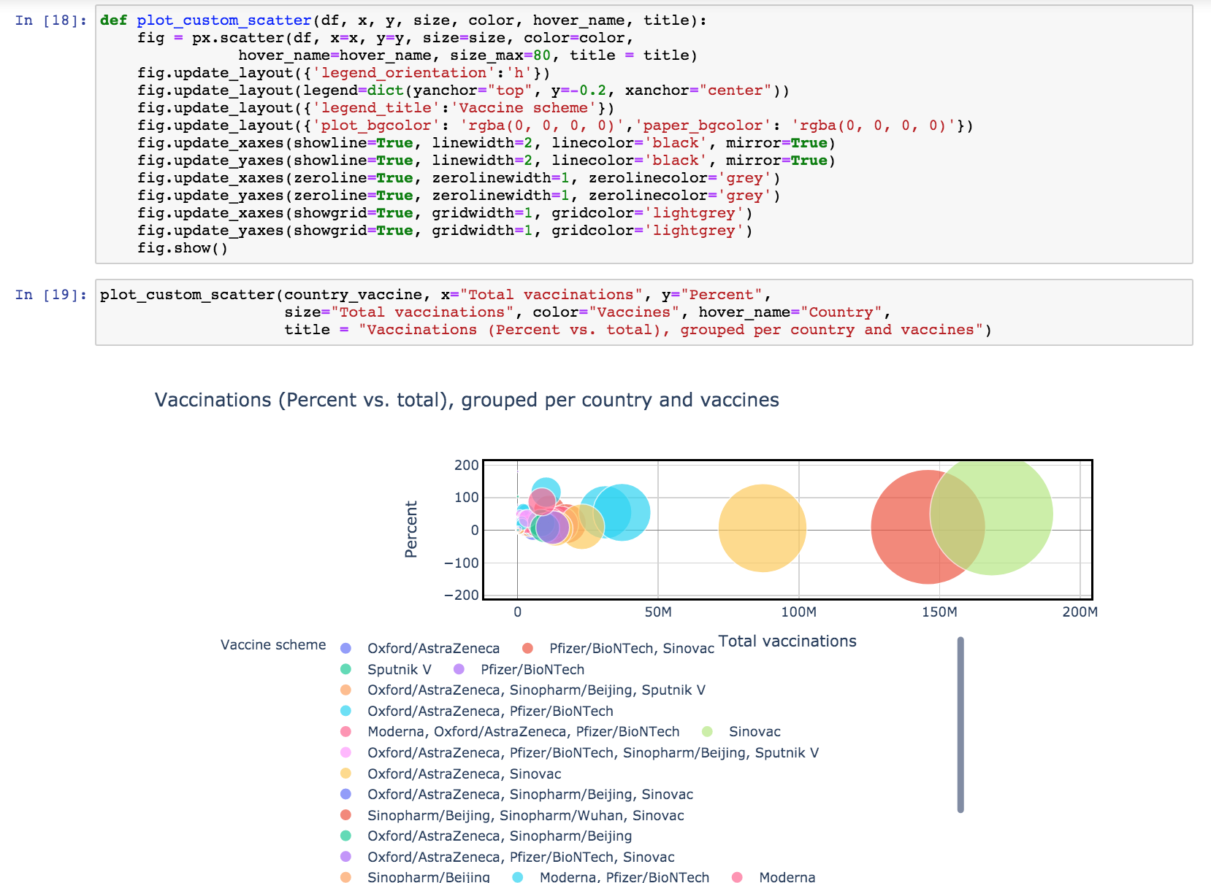
Experiments
& Results
Scatter Graphs
CONCLUSIONS

Slide 11
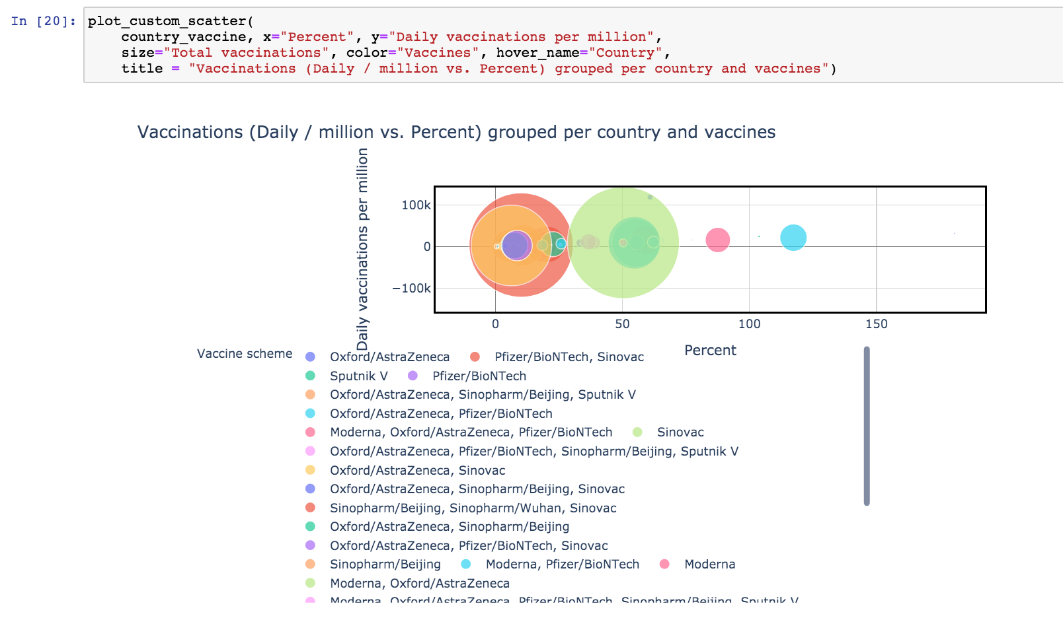

Slide 12
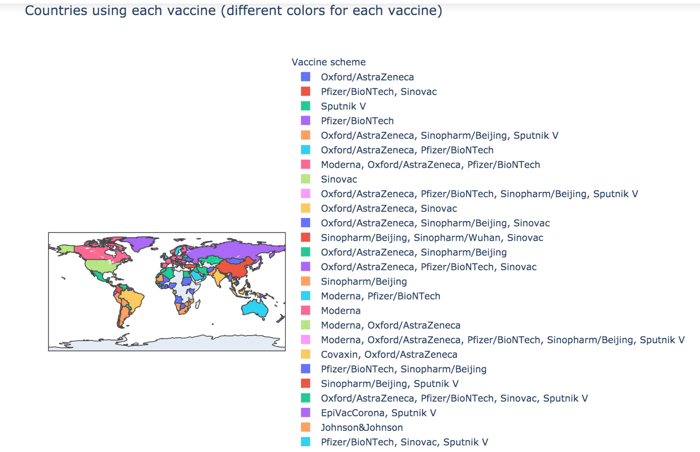
Experiments
& Results
Choropleth Map
Diversificated vaccine schemes
The most popular vaccine provider is Oxford/AstraZeneca
Notes:
Mehreet starting

Slide 13
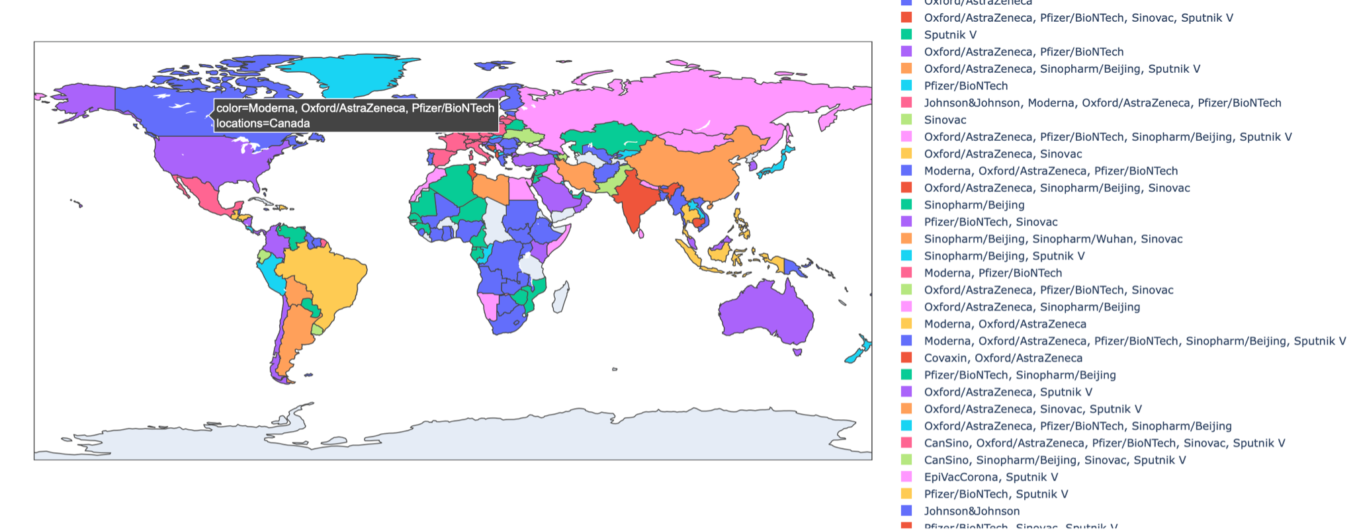

Slide 14
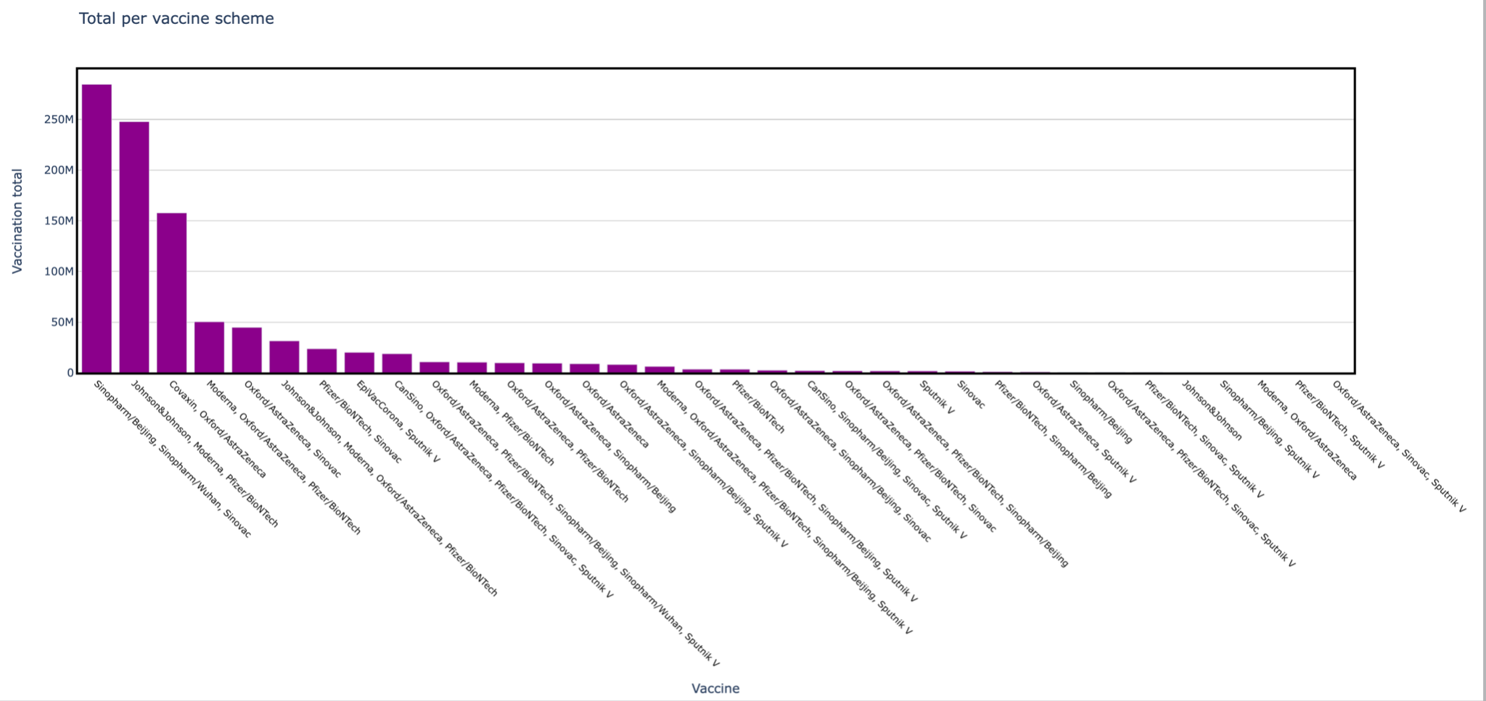
Trace Bar Graphs
As per Vaccine scheme

Slide 15
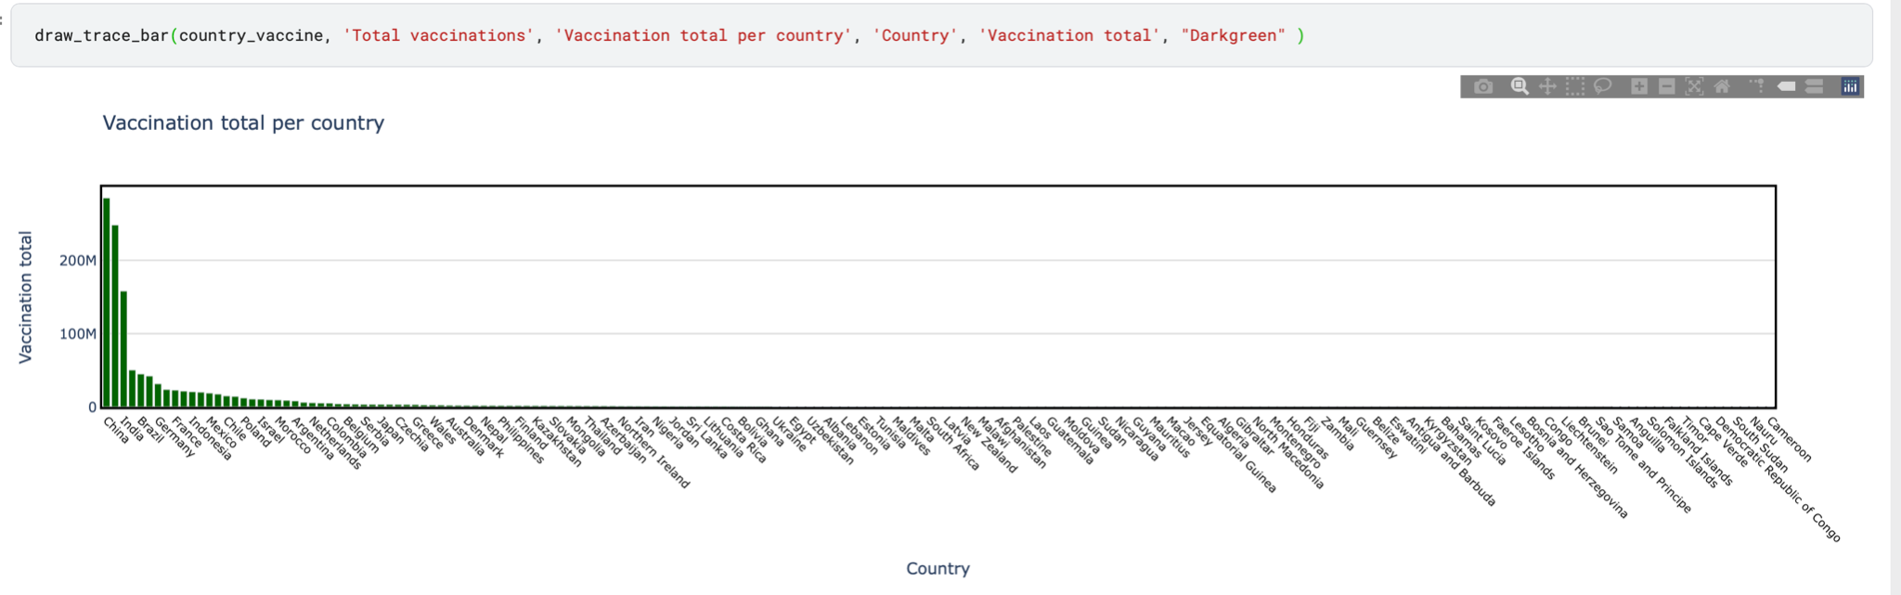
Irrespective of vaccine scheme

Slide 16
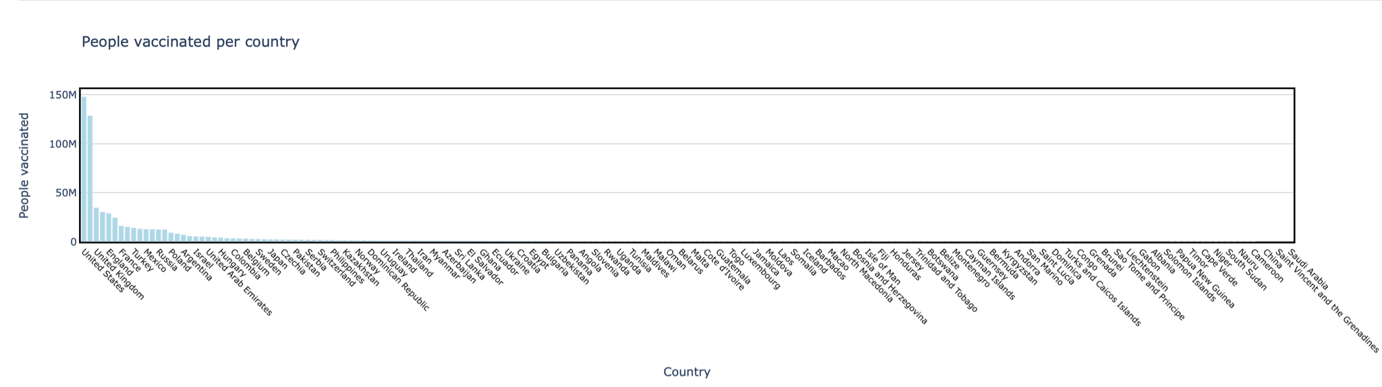
Irrespective of vaccine scheme

Slide 17
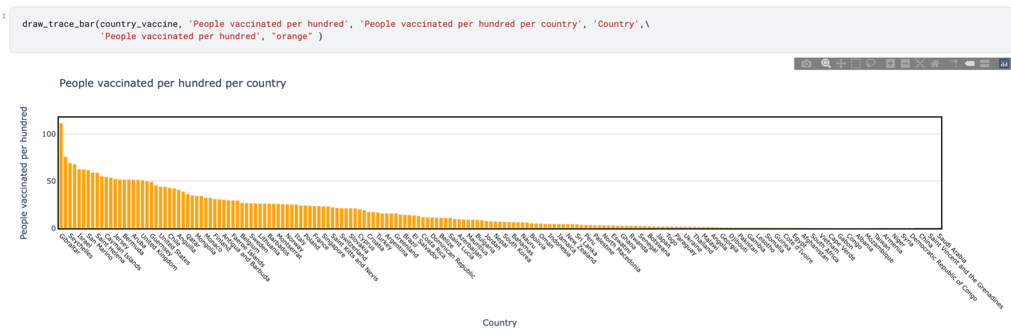
Irrespective of vaccine scheme

Slide 18
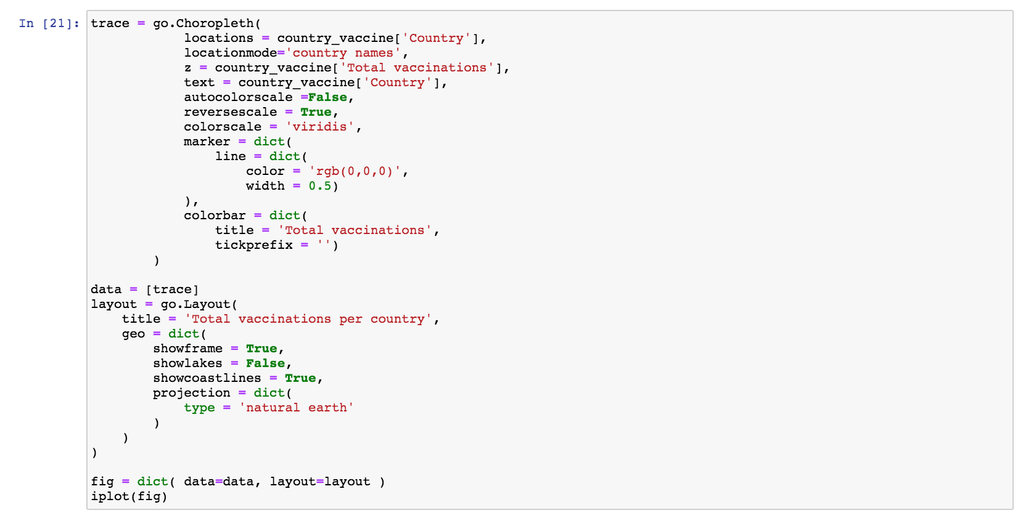
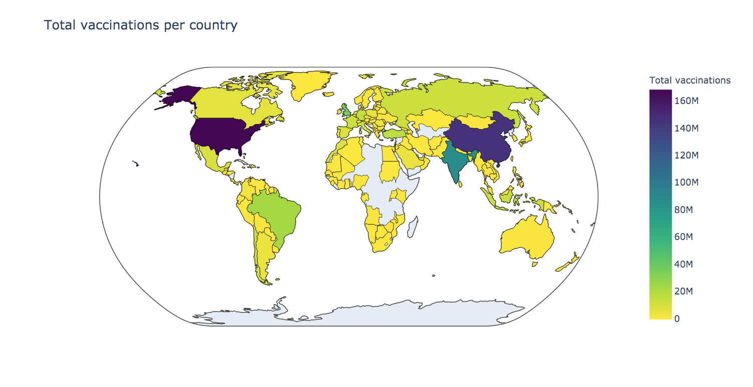
Experiments
& Results
Geo Choropleth

Slide 19
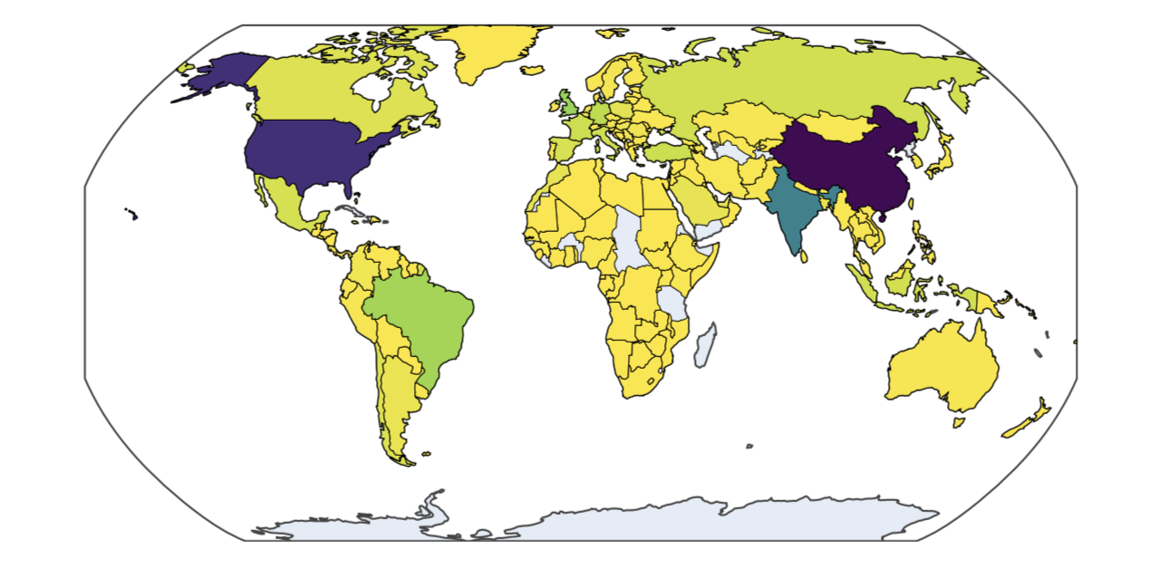
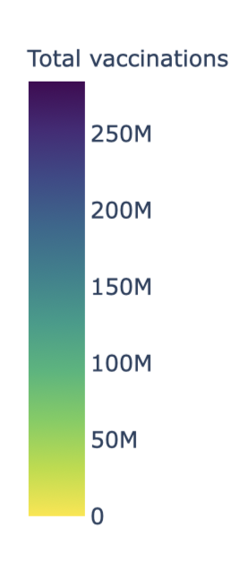
TOTAL VACCINATIONS PER COUNTRY

Slide 20
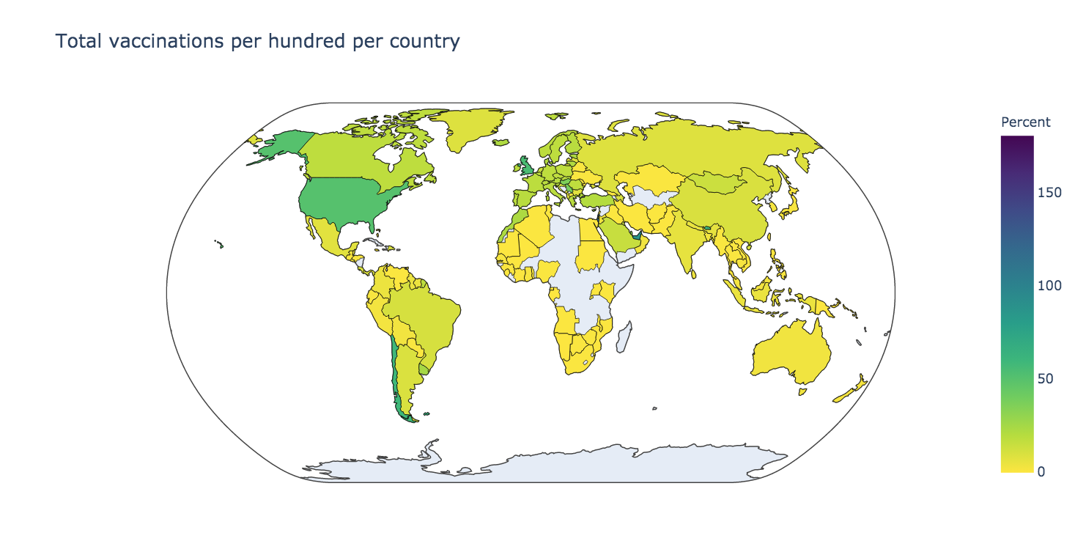
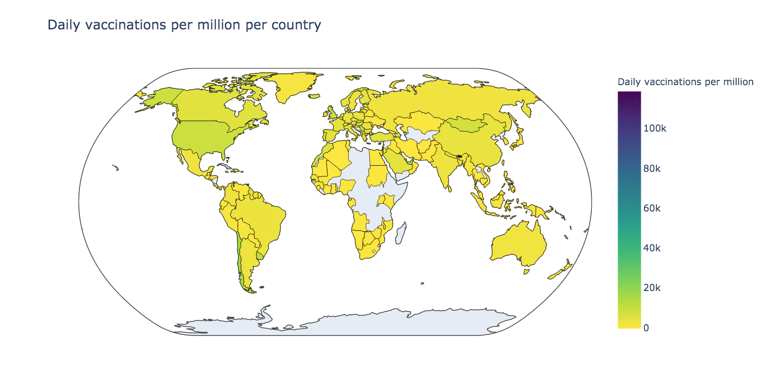
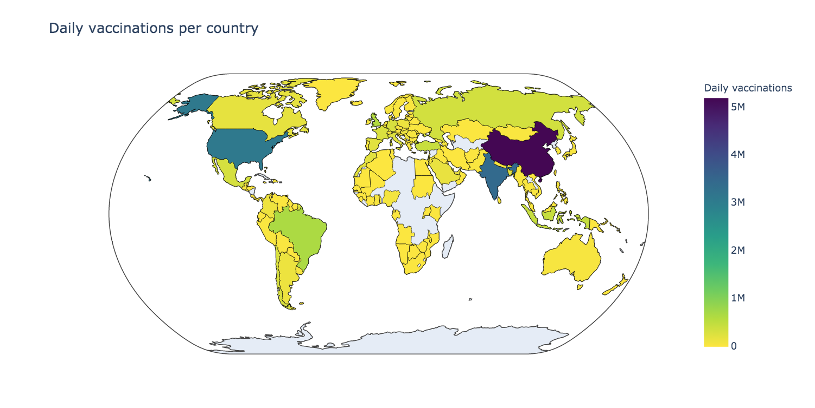
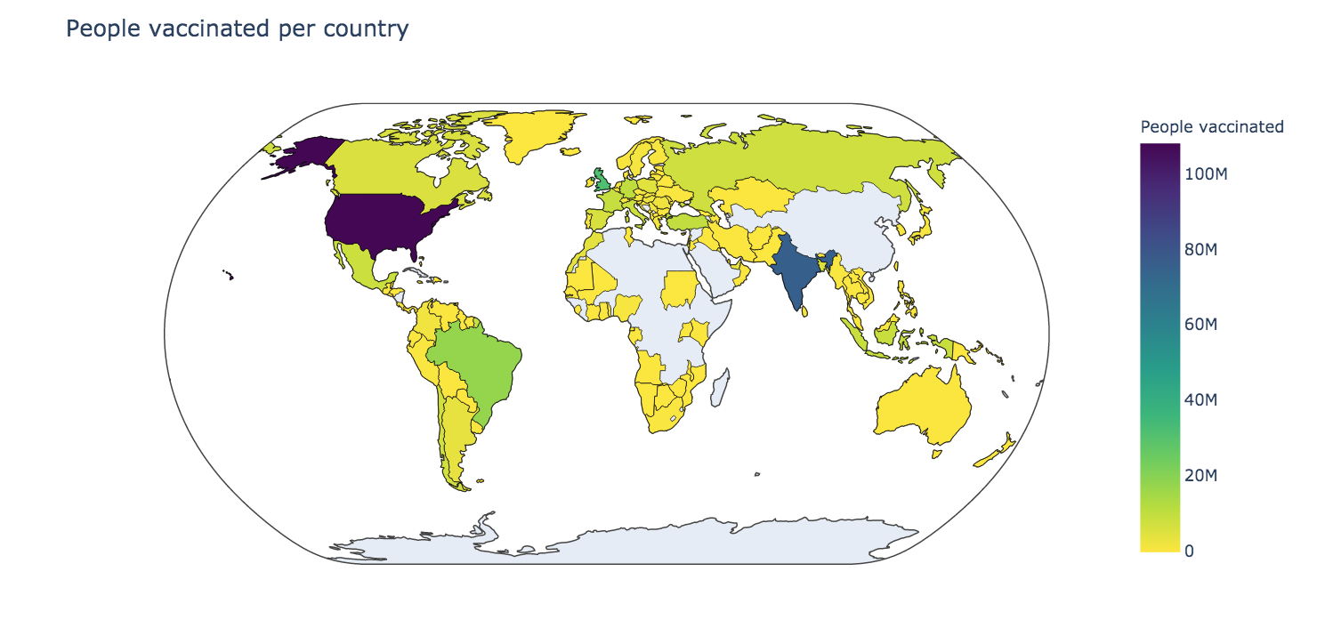
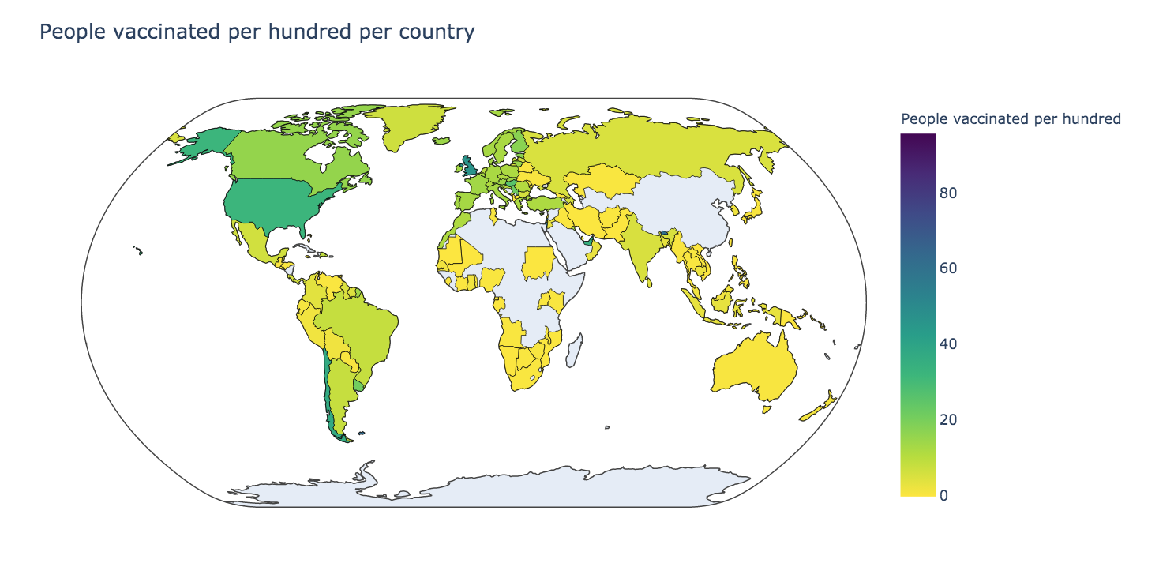

Slide 21
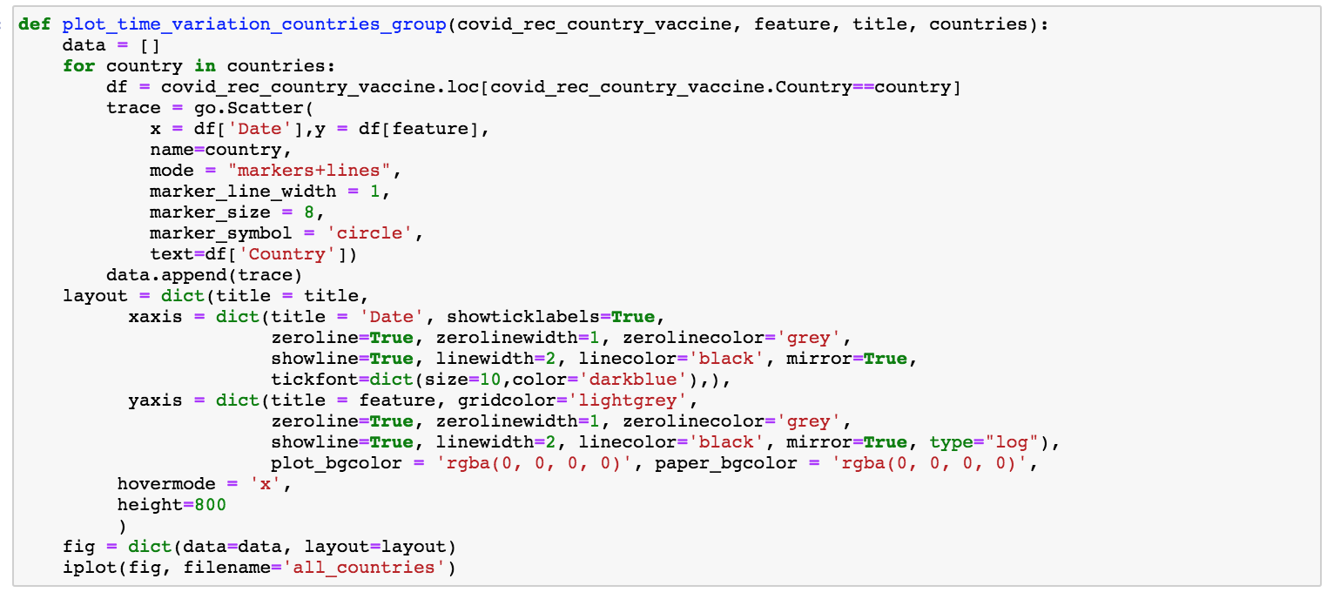
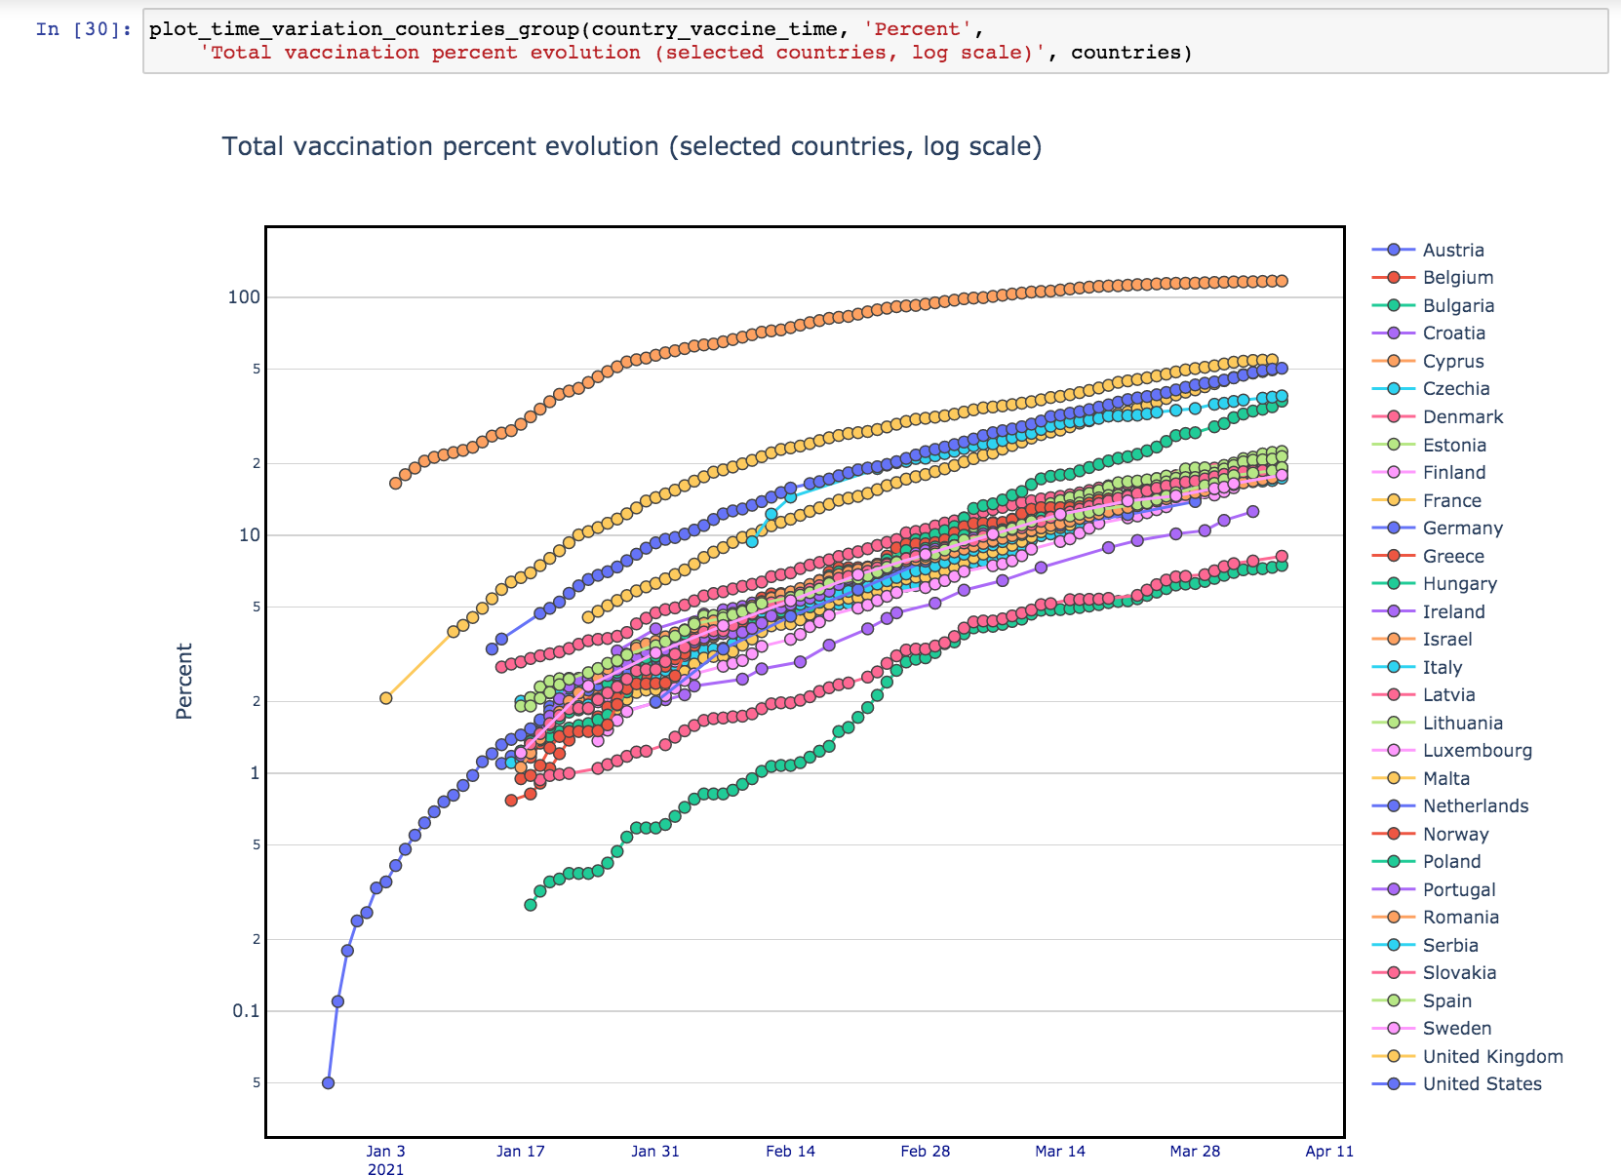
Experiments
& Results
Scatter Plots
CONCLUSIONS

Slide 22
Lets go visualize these graphs from our notebook
Notes:
Mehreet End

Slide 23
Plotly?
Plotly has hover tool capabilities that allow us to detect any outliers or anomalies in a large number of data points.
It is visually attractive that can be accepted by a wide range of audiences.
It allows us for the endless customization of our graphs that makes our plot more meaningful and understandable for others
Notes:
Added

Slide 24
Future Work and Consideration
We learned that different data visualization technique gives us a more specific insight of the data
Continue developing this project until final due date
Apply regression techniques to preview future progress of vaccine
Analyze each country’s population demographics to better understand the vaccine effectiveness
Do an analysis of COVID data for countries that are distributing the vaccine vs. countries that are not, as part of our analysis of vaccine effectiveness

Slide 25
References
https://docs.python.org/3/tutorial/index.html
https://plotly.com/python/maps/
https://www.kaggle.com/datasets

Slide 26
Thank you!
Questions & Feedback

